Slide 1
Computational Thinking
presented by Group 5

Slide 2
About the Team
Dex from Xi’an Jiaotong-Liverpool University
Jing from University of Electronic Science and Technology of China
Siqi from University of Electronic Science and Technology of China

Slide 3
New Insights on Big Data
Basic usage of R
Unleash the power of large size of file
Basic understanding of community detection
Several Algorithms to find MST and shortest path

Slide 4
Code on node_calculator
return(length(unique(unlist(data[1:2]))))

Slide 5
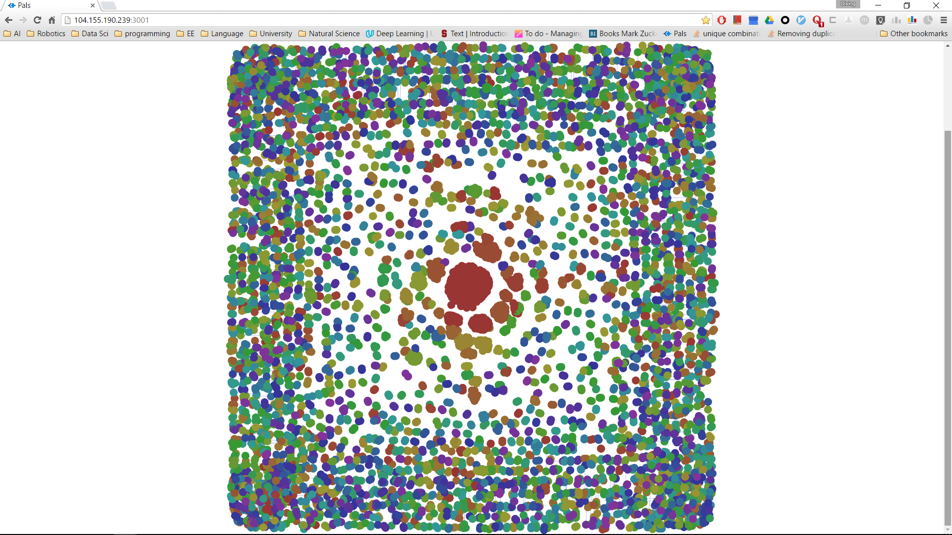
Visualization for Assignment1
5000 pairs of nodes powered by pal system, provided by Dex

Slide 6
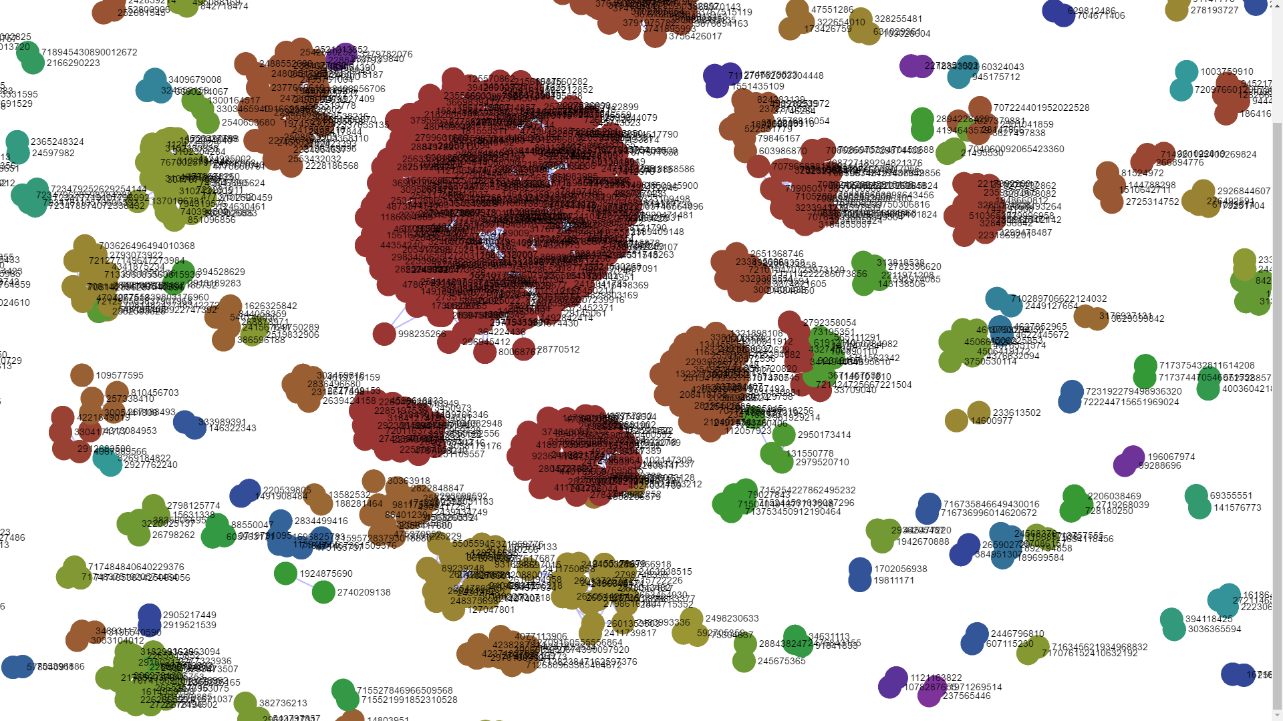
Visualization for Assignment1
zoomed in and found out the communities of network graph

Slide 7
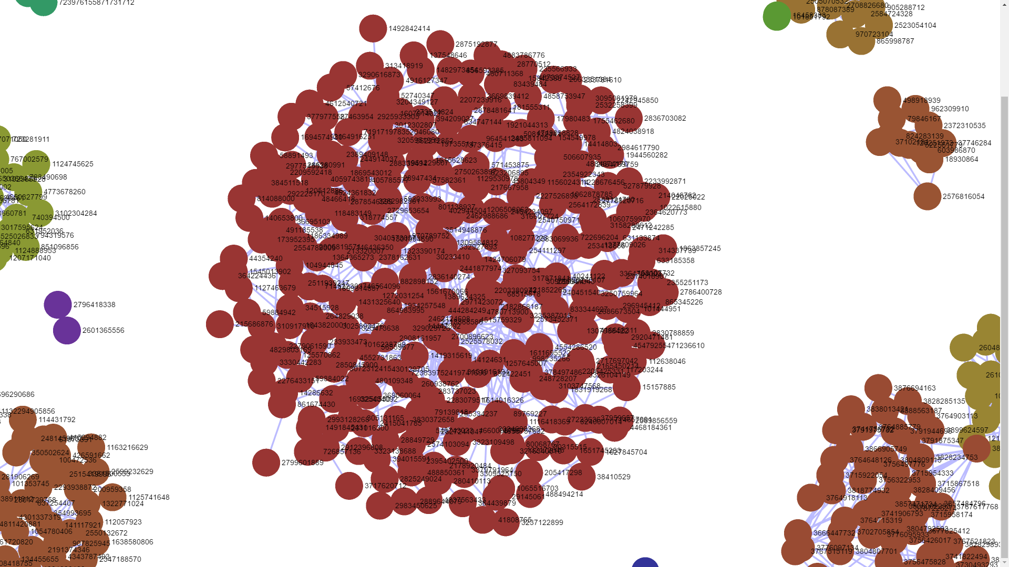
Visualization for Assignment1
zoomed in and found out the communities of network graph

Slide 8
Code on Visualizing
g <- function(df){
a <- graph_from_data_frame(df, vertices=unique(c(df$V1, df$V2)), directed=F)
b <- edge.betweenness.community (a, weights = E(a)$weight, directed = FALSE, edge.betweenness = TRUE, merges = TRUE, bridges = TRUE, modularity = TRUE, membership = TRUE)
plot(b,a)
}

Slide 9
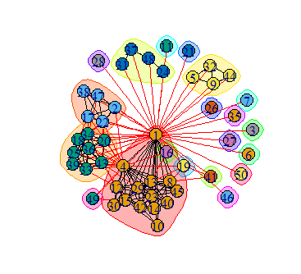
Visualization for G1.txt
clearly see the communities
with small dataset powered
by igraph

Slide 10
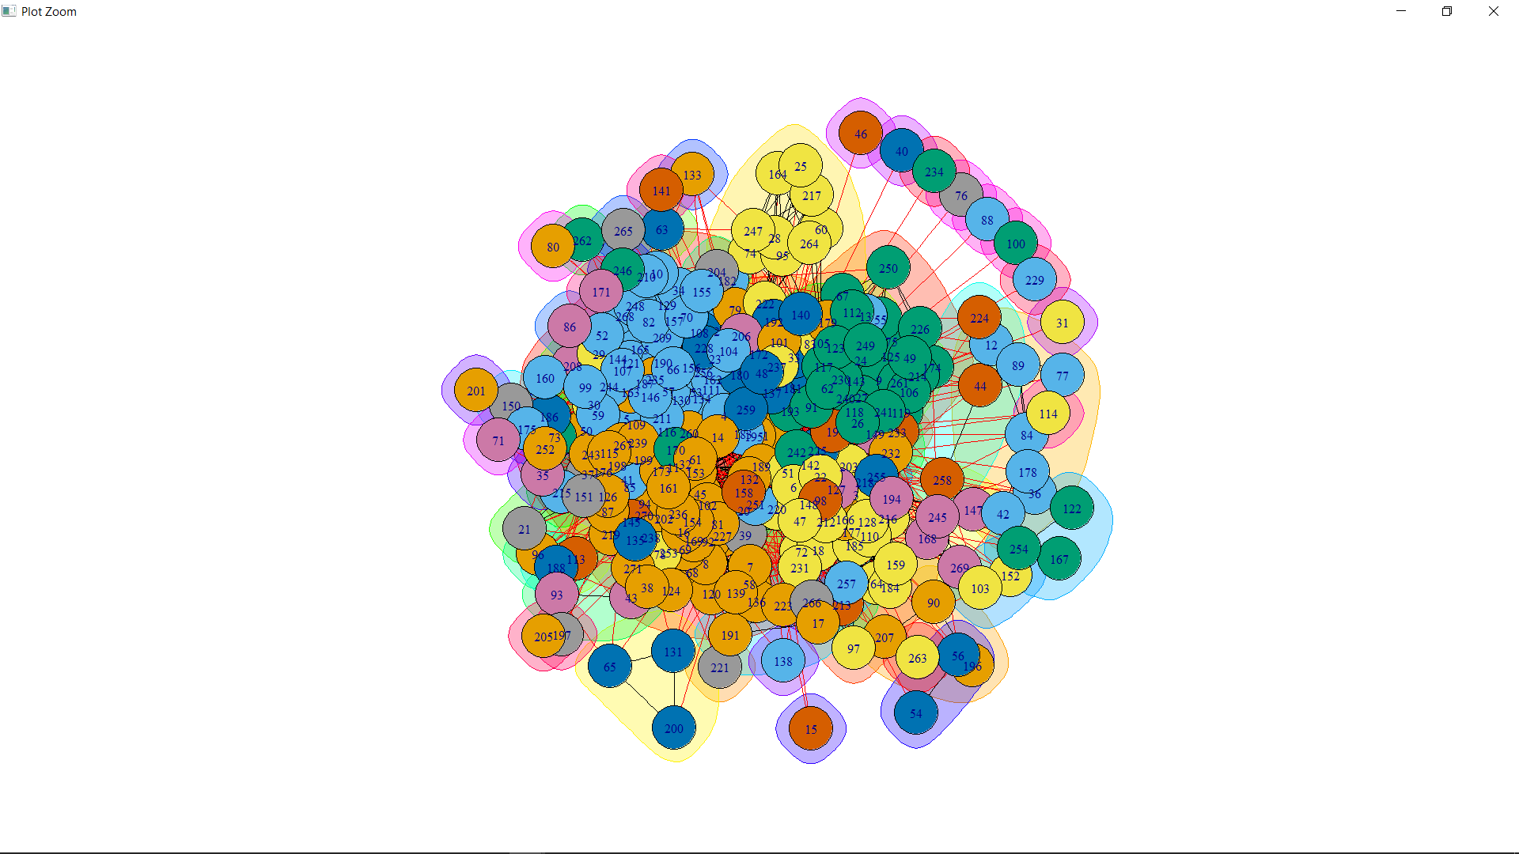
Visualization for G2.txt

Slide 11
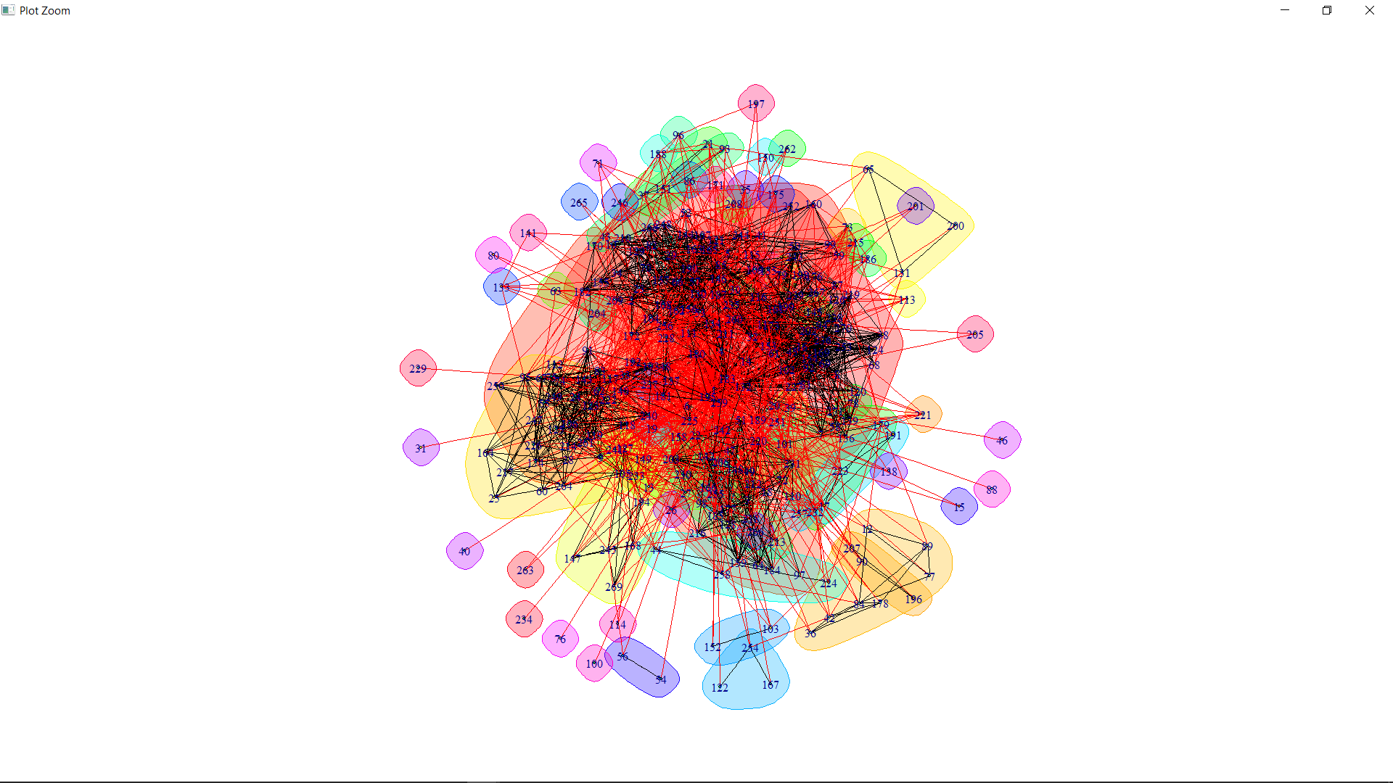
Visualization for G2.txt
shrink the size of nodes and the pattern became more obvious

Slide 12
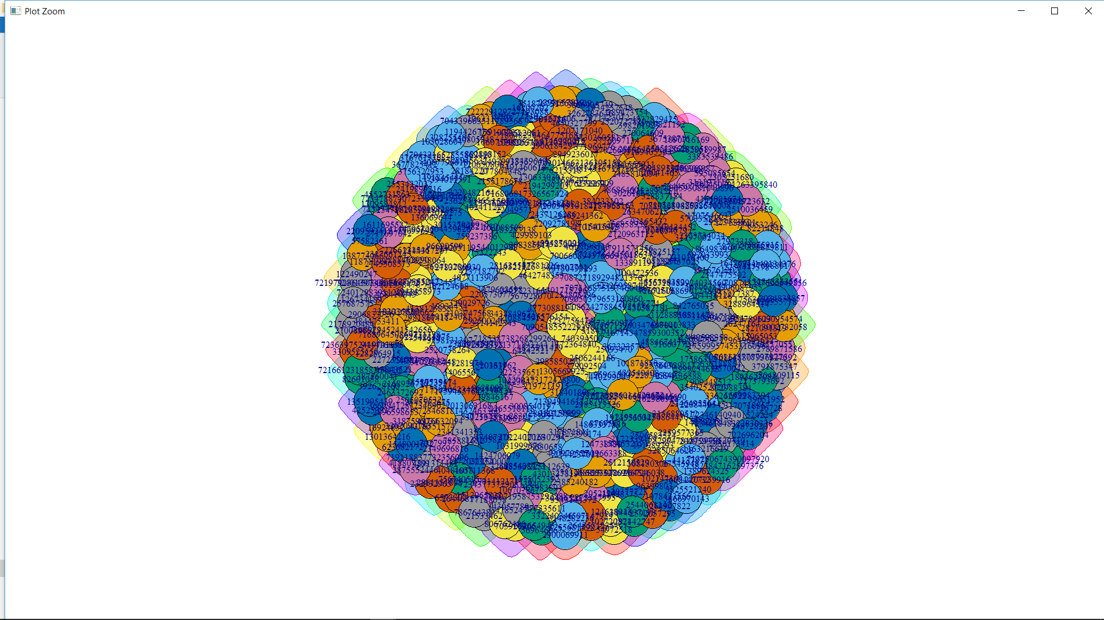
Visualization for G3.txt

Slide 13
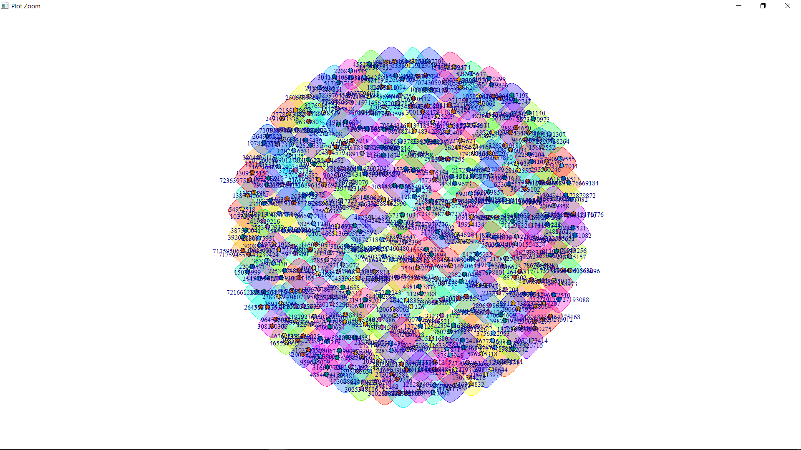
Visualization for G3.txt
since communities are diverse in this graph, it is less effective to shrink the
size of node.

Slide 14
Thank you!

